Slide 1
Transunion Intern
S.HARI KRISHNAN
R.M.K ENGINEERING COLLEGE

Slide 2
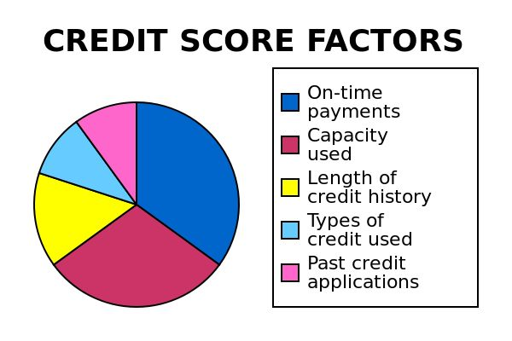
About the company:
1. Transunion is a credit information service bureau company.
2.It offers total credit protection all in one place from credit score,credit report, and credit alert.

Slide 3
PROCESS FLOW DIAGRAM:
Contains credit history data and Calculates CIBIL(Credit)
Score
Transunion
Consumer
Financial Institution(Banks)
A person who purchases goods and services.
Asks for consumer details like Aadhar,PAN,Bank Account etc.

Slide 4
ETL:
1.ETL technology is used to extract data from source databases, transform and cleanse the data and load it into a target database.
2.It is an important component in the set Data Warehousing technologies.
3.The principal differences between ETL and conventional methods of moving data is its ease-of-use. A user friendly graphical interfaces is available to quickly map tables and columns between the source and target databases.
Features:
1.Efficient batch and real time processing.
2.scalability and performance.
3.Easy integration with webservices.

Slide 5
ETL process flow diagram:
FLAT FILE data
BUSINESS INTELLIGENCE
JSON data
ETL
DATA WAREHOUSE(OLAP)
XML data
MYSQLDB
ORACLE DB

Slide 6
About Ab initio:
1.Ab Initio is a Extract Transform Load (ETL) tool to handle massive volumes of data.
2. In every instance, Ab initio completed processing of the datasets before the other.
3. It can split large datasets into smaller datasets and then process the smaller datasets in parallel, utilizing as many CPU’s and as much memory as you choose to allocate.
4. It tends to function best on UNIX/LINUX servers and can take full advantage of server resources ,if allowed.
VERSION:3.2.6.1 COOPS: 3.2.7.10
Limitations:
1. Accessing the database almost every instance every instance represents the slowest processing for Abnitio.
2. This tool is very costly,compared to other tools.

Slide 7
Architecture of Abnitio:
GDE:It provides an intuitive graphical interface for editing and executing applications.
Cooperating system:It provides a general engine for integration of all kinds of data processing and communication between all the tools within the platform.
EME: It is a data store that allows tracking changes in developed graphs and metadata used in their development.
Enterprise Metadata Environment(Repository)
Graphical Development Environment(GDE)
Cooperating System

Slide 8
Stakeholders Role:
Demo meeting
Final product
Review meeting
customer
Market
Customer service
Project Manager
Product Manager(gives feedback)
Establish project
Improvement plan
start
Product requirement list
Build product
Dev Team
Test Team
Support Team

Slide 9
Software Development Life Cycle(SDLC):
It usually has seven phases namely ,
1.Planning.
2..Analysis and requirements
3.System Design.
4.Development.
5.Integration and Testing
6.Implementation
7.operations & maintenance.

Slide 10
Waterfall model:
1.The Documentation is produced at each phase and that it fits with other engineering process models.
2.It is a linear sequential life cycle model.
3.The requirements/quotations cannot be modified at the working stage or ongoing process.
4.Phases are processed and completed one at a time.
Disadvantages:
1.High amounts of risk and uncertainty.
2.Poor model for long and ongoing projects.
3.Time to build and release the product into market is low.

Slide 11
AGILE MODEL:
Values:
1.Individuals and interactions(They have own skill set) over processes and tools.
2.customer collaboration over contract negotiation.
Principles:
1.Highest priority is to satisfy customer through early and continuous delivery of valuable software.
2.Business people and developers must work together daily throughout the project.
3.Agile process harness change for the customer’s competitive advantage.
Implementation:
Scrum framework(sprints time span for 2 to 4 weeks)
Kanban
xp(Extreme programming)

Slide 12
Scrum key roles:
1.Product owner -key stakeholder who provides direction to team for each sprint
2.Team members- Do the tasks regularly.
3.Scrum master -facilitator focuses completely on process.
Four meetings in scrum:
sprint planning-what we are going to achieve and who is doing what.
standup-Is Everything going correct acccording to plan?
Review-Deliver results and receive your feedbacks.
Retrospective-Look back on process and reflect improvement.

Slide 13
Tech Stack Environment Softwares:
DEVELOPMENT SIDE :
1.ABNITIO -It is a ETL tool to handle massive volumes of data.
2.MSSQL -It is a RDBMS built for basic function of storing,retrieving data as required by another application
3.VISUAL STUDIO -Used to develop computer programs for websites,web app,web services etc.
4.ORACLE - Used for creating database,tables,records etc.
5.UNIX/LINUX-(PUTTY)-It is an OS capable of handling activities from multiple users at same time.
QA TESTING :
1.SOAP TOOL-It allows testers to execute automated functional, regression, compliance, and load tests on different Web API.
2. ROBOT -It is a Python-based, extensible keyword-driven automation framework for acceptance testing, acceptance test driven development (ATDD), behavior driven development (BDD) and robotic process automation (RPA).
3. MTM /TFS-It is used to create and organize test plans and test cases, and execute manual tests.
SUPPORT AND MAINTANENCE(LIVE):
1.SPLUNK-Splunk's mission is to make machine data accessible across an organization by identifying data patterns, providing metrics, diagnosing problems, and providing intelligence for business operations.

Slide 14
THANK YOU

